Slide 1


Slide 2
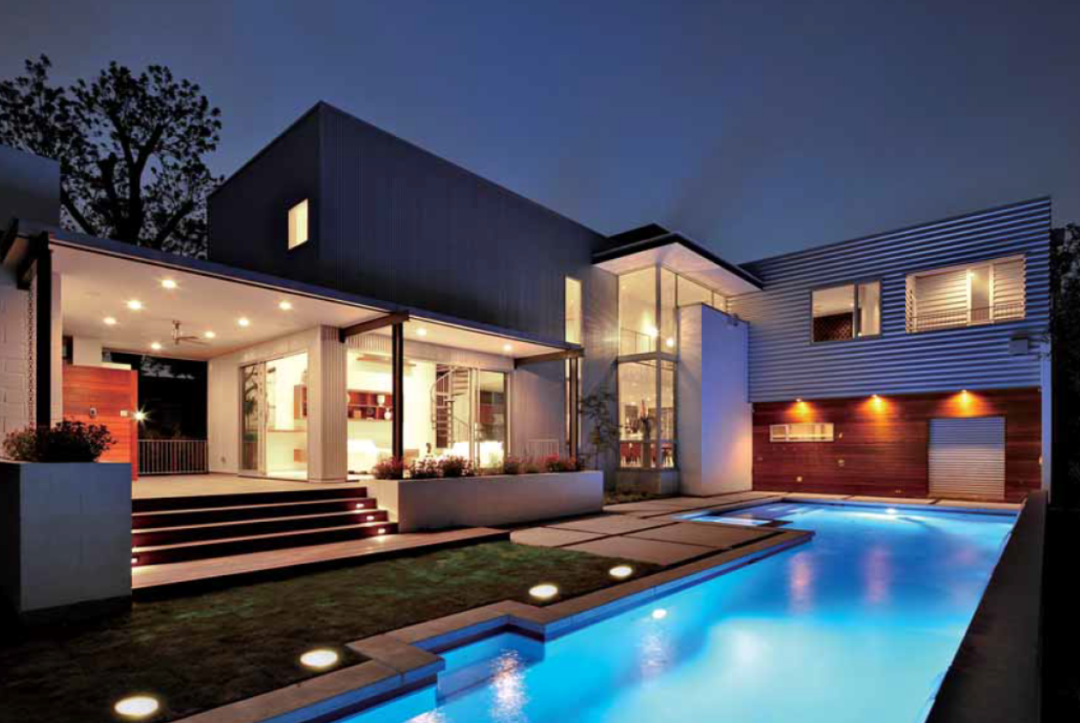

Slide 3
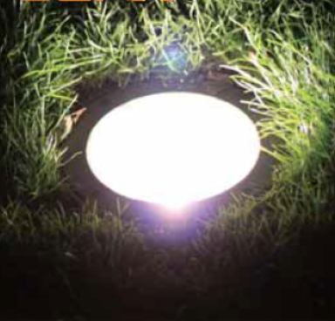
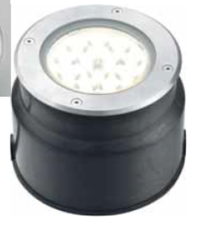
LED OUTDOOR LIGHT
MODEL | LED Uplight 12W

Slide 4
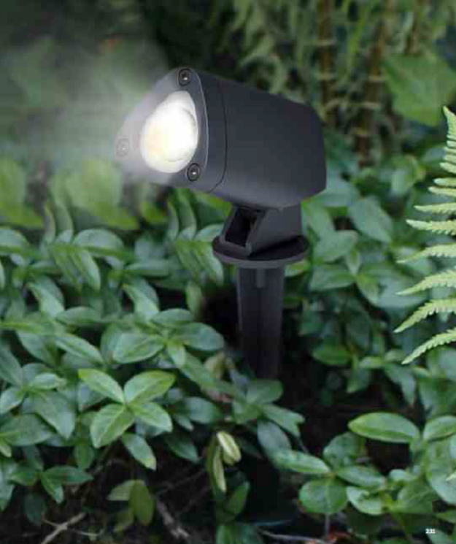
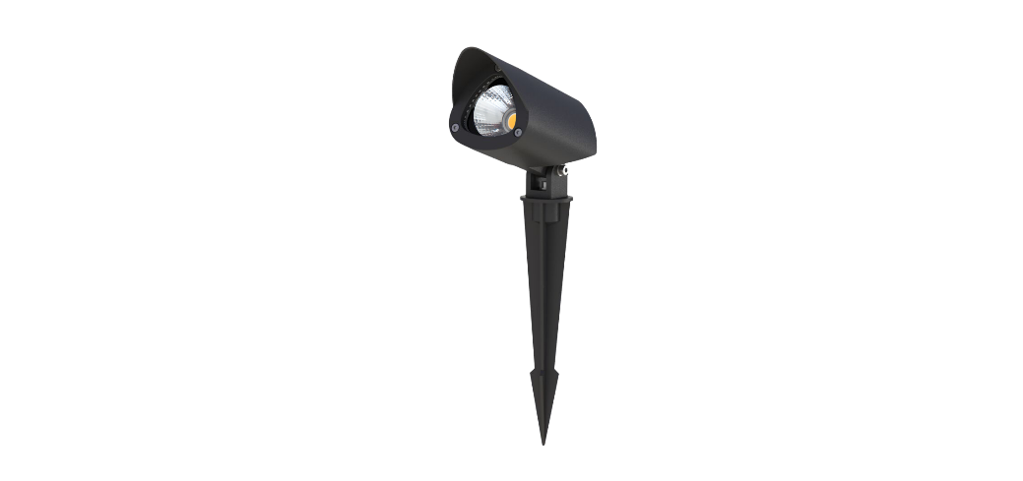
LED OUTDOOR LIGHT
MODEL | LED Garden Light 7W

Slide 5
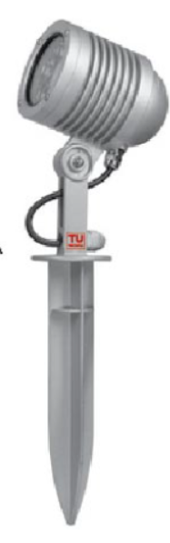
LED OUTDOOR LIGHT
MODEL | LED Garden Light 8W

Slide 6
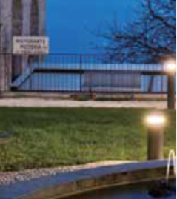
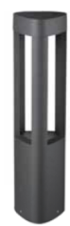
LED OUTDOOR LIGHT
MODEL | LED Garden Light bollard 9W

Slide 7
LED OUTDOOR LIGHT
MODEL | LED Step Light 2W

Slide 8
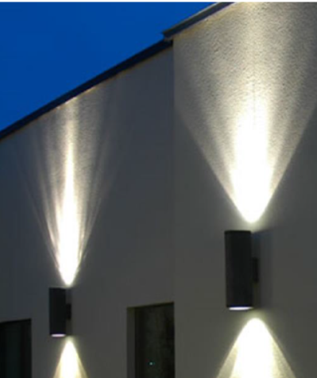
LED OUTDOOR LIGHT
MODEL | LED Up&Down Light
 | 2*11W

Slide 9
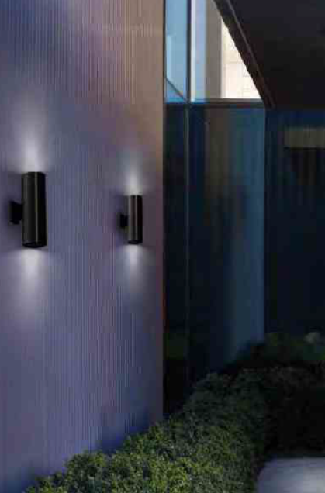
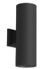
LED OUTDOOR LIGHT
MODEL | LED Up&Down Light
 | 2*10W

Slide 10
LED OUTDOOR LIGHT
MODEL | LED Bulk Head Light
 | 9-11W

Slide 11
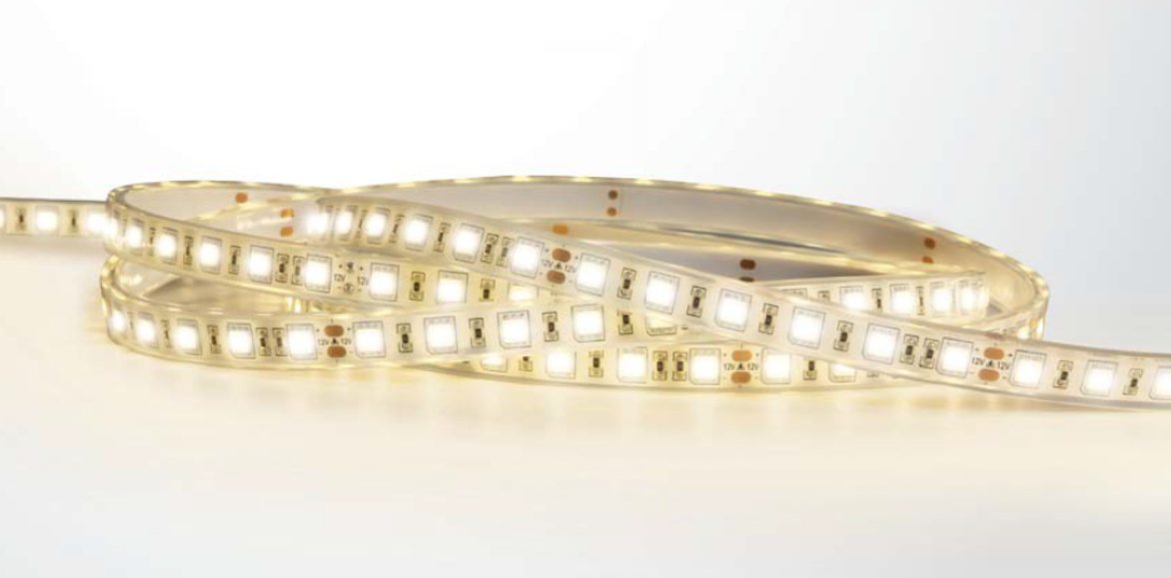
LED OUTDOOR LIGHT
MODEL | LED Strip Light
 | 4.4 W/m

